Slide 1
Finding the Keys to Victory in League of Legends Games
Team 2: Tao Shan, Apollo Lin, Hansen Liu, Adam Qian, Yao Zhao

Slide 2

Table of Contents
Introduction ∙ ∙ ∙ ∙ ∙ ∙ ∙ ∙ ∙ ∙ ∙ ∙ ∙ ∙ ∙ ∙ ∙ ∙ ∙ ∙ ∙ ∙ ∙ ∙ ∙ ∙ ∙ ∙ ∙ ∙ ∙ ∙ ∙ ∙
Motivation ∙ ∙ ∙ ∙ ∙ ∙ ∙ ∙ ∙ ∙ ∙ ∙ ∙ ∙ ∙ ∙ ∙ ∙ ∙ ∙ ∙ ∙ ∙ ∙ ∙ ∙ ∙ ∙ ∙ ∙ ∙ ∙ ∙ ∙ ∙ ∙
Methodology ∙ ∙ ∙ ∙ ∙ ∙ ∙ ∙ ∙ ∙ ∙ ∙ ∙ ∙ ∙ ∙ ∙ ∙ ∙ ∙ ∙ ∙ ∙ ∙ ∙ ∙ ∙ ∙ ∙ ∙ ∙ ∙ ∙ ∙
Experiment Results ∙ ∙ ∙ ∙ ∙ ∙ ∙ ∙ ∙ ∙ ∙ ∙ ∙ ∙ ∙ ∙ ∙ ∙ ∙ ∙ ∙ ∙ ∙ ∙ ∙ ∙ ∙ ∙ ∙
Discussion ∙ ∙ ∙ ∙ ∙ ∙ ∙ ∙ ∙ ∙ ∙ ∙ ∙ ∙ ∙ ∙ ∙ ∙ ∙ ∙ ∙ ∙ ∙ ∙ ∙ ∙ ∙ ∙ ∙ ∙ ∙ ∙ ∙ ∙ ∙ ∙
Conclusion ∙ ∙ ∙ ∙ ∙ ∙ ∙ ∙ ∙ ∙ ∙ ∙ ∙ ∙ ∙ ∙ ∙ ∙ ∙ ∙ ∙ ∙ ∙ ∙ ∙ ∙ ∙ ∙ ∙ ∙ ∙ ∙ ∙ ∙ ∙
3
6
9
29
32
34

Slide 3
League of Legends
League of Legends is a online multiplayer video game
Two teams of 5 fight to win by destroying the other team’s main building called a nexus

Slide 4
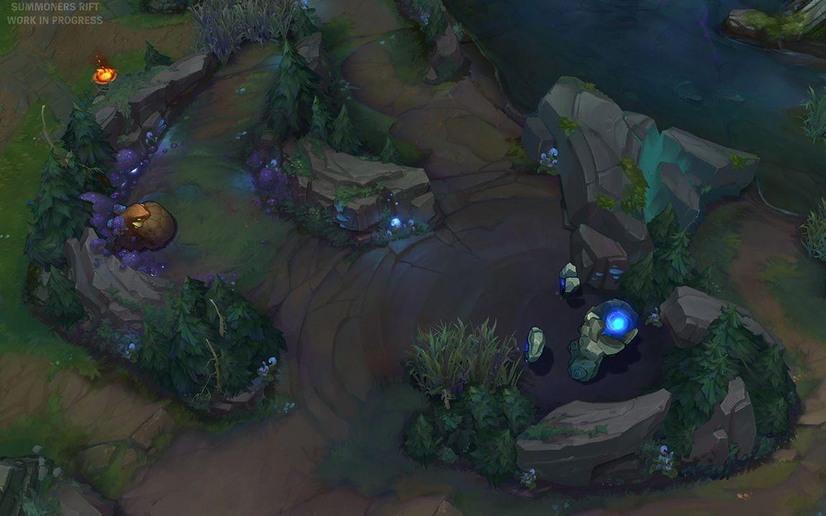
League of Legends
There are many secondary objectives both teams can pursue to help achieve the main objective of destroying the nexus

Slide 5
The Problem
?
Can we use various in-game metrics to accurately predict the outcome of a game and which secondary objectives are most important to victory ?

Slide 6
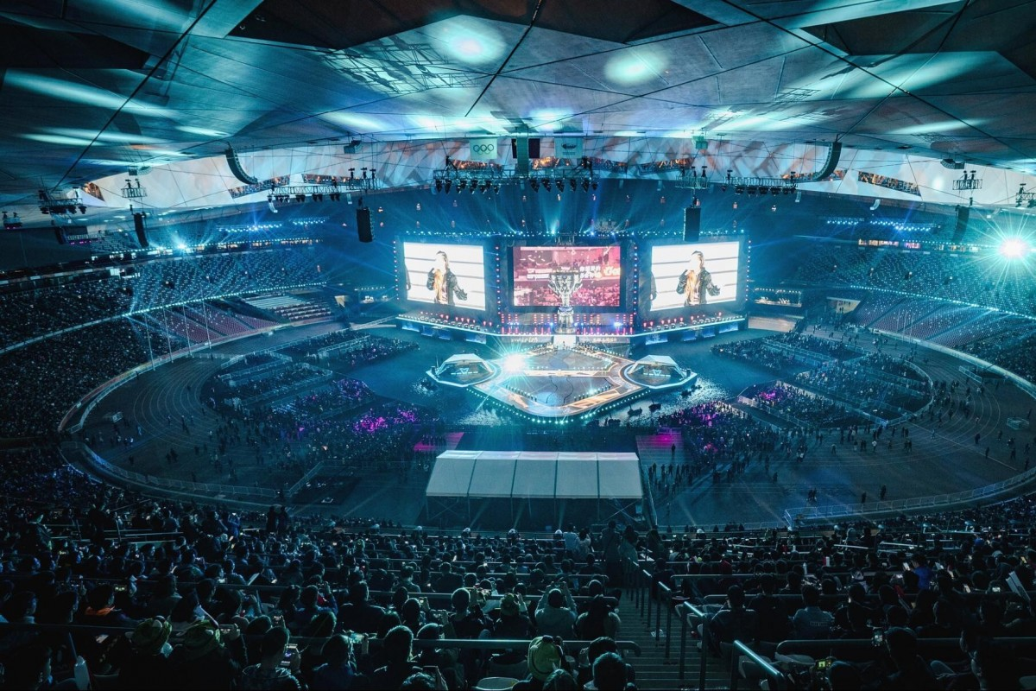
Why Winning Matters
150 million registered players
Many competing with each other to get better and achieve high ranks
Huge prize pools for winning teams… $6.5 million USD prize pool in world championships in 2018

Slide 7

Our Data
Detailed records on ~12,000 recent games played by players of a similar skill level
Collected directly from Riot Games, the developer of League of Legends, via an API

Slide 8
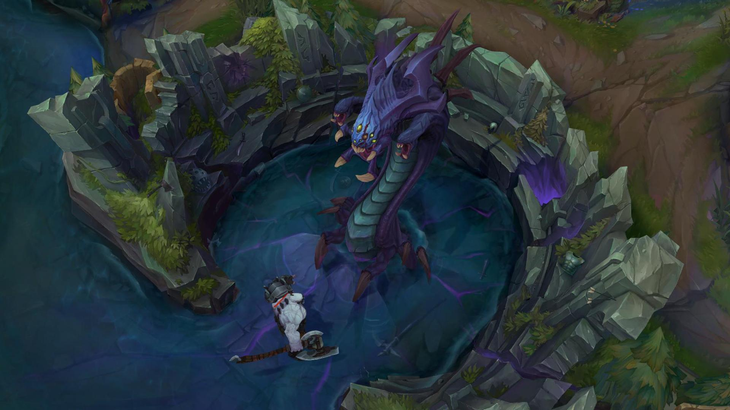
Our Data
Each player’s contribution towards strategic objectives throughout the game
Players’ ability to combat other players on the enemy team
Effectiveness of each team at achieving secondary objectives and how quickly they can achieve them

Slide 9

Data exploration
Filling missing values
Types of columns
Histogram
Correlation map

Slide 10
Filling missing values – exploration
16 columns has missing value
10% - 25% for each column
All categorical type
5-150 unique values

Slide 11
Filling missing values
Fill with nearby values?
Python IterativeImputer
Estimator: decision tree

Slide 12
Types of columns
Types: string, numerical, float
Discrete numeric -> categorical
(unique value < 20)
Discrete numeric -> continuous numeric
(unique value > 50)
Check unique values for categorical

Slide 13
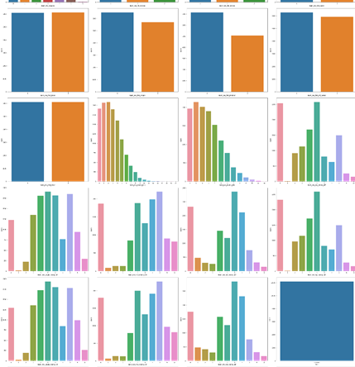
Histogram

Slide 14
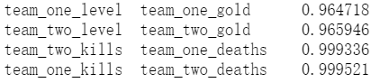
Correlation map
Find multicollinearity
Delete one of the feature for each pare > 95% correlation

Slide 15
Data Preprocessing
Label Encoder
Binning methods
Min-Max Scaler

Slide 16
Label Encoder
Categorical type:
When unique value < 20, onehog encoder
When unique value 20-50, label encoder
When unique value > 50: binning.

Slide 17
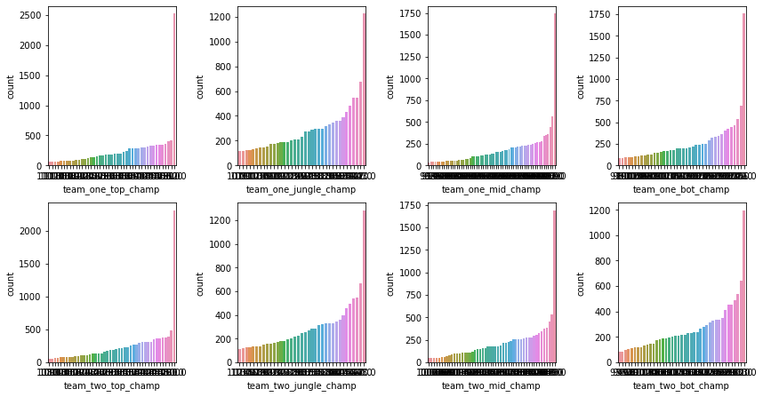
Binning

Slide 18
Feature Selection
Python model selection: decision tree, random forest,
Adaboost, Ridge Classifier
Python select K best: f score
Combine the selection result
Example: team_one_first_inhibitor, team_one_level, team_one_obj_damage, team_one_dragons, team_one_champ_damage, etc. (36 columns)
Reduce columns: 173 -> 36

Slide 19
Clustering
PCA
K means, DBSCAN, Hierarchical clustering

Slide 20
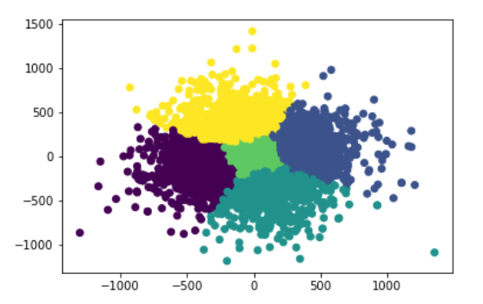
K means
Select K: inter, intra distance

Slide 21
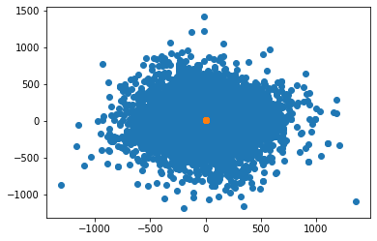
DBSCAN
Silhouette Score: -0.22

Slide 22
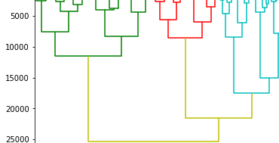
Hierarchical clustering
High computational cost

Slide 23
XGBoost
Gradient boosted decision tree
Initial cross validation score with 5 folds: 0.971
Hyperparameter pruning : learning rate, max depth, etc.
Final score: 0.972
XGboost + Bagging: 0.975, but high computational cost.

Slide 24
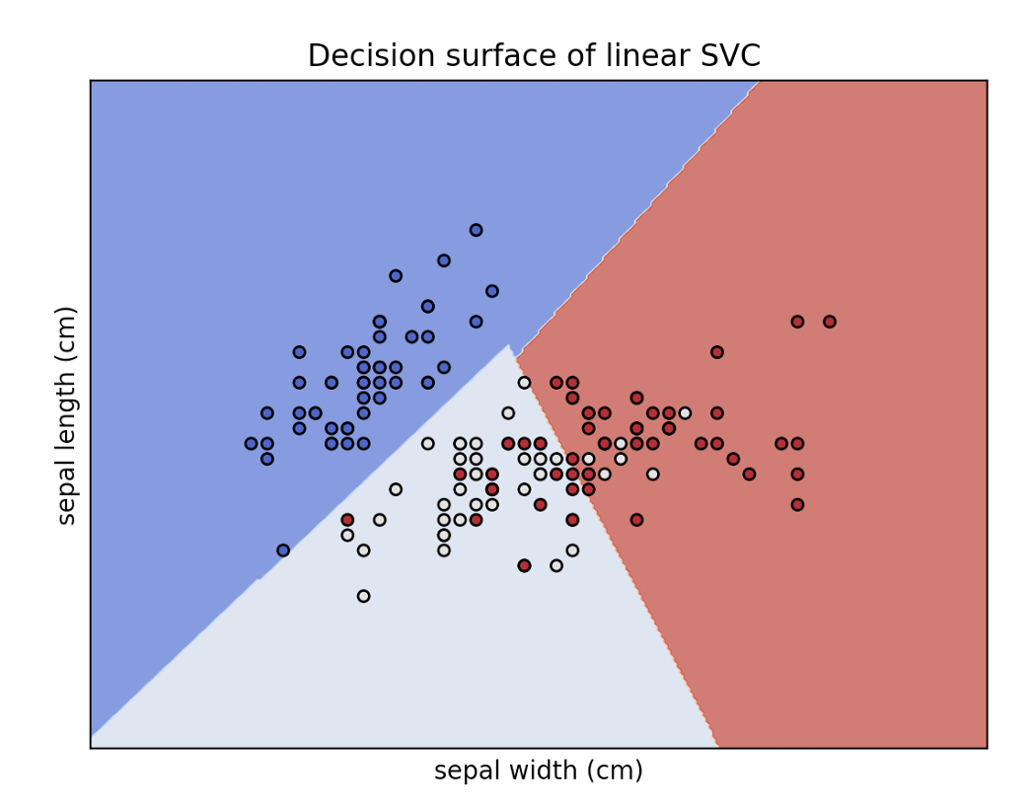
SVM
SVM is great for 2-class classification problem and works extremely well for problems that require a higher dimension.
Use SVC classifier to help build the model
Generate optimal hyperplane

Slide 25
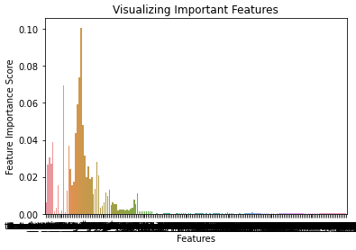
Random Forest - Feature Selection -hansen
Top 6 Features:
team_one_first_inhibitor
team_one_kills
team_two_kills
team_one_obj_damage
team_two_obj_damage
Team_one_deaths
Note that a few features have significantly higher gini importance than majority.
Notes:
This is our visualization of the gini importances of the features. Note that with 171 features, the average should be 0.00584,, so seeing features with over 0.04 is highly significant.
Through calculating the gini importances of the features, which is essentially the weighted importance of the features (where they all sum to 1) we can identify our top features at a glance.
As the goal of every lane is to push turrets (objective damage) to destroy the enemy inhibitor (first inhib), and get kills in the process (while avoiding death), it is intuitive that these features have high predictive accuracy.
It is important to note that as the game goes on, the odds of a victory change- these features reflect critical turning points in every match.

Slide 26
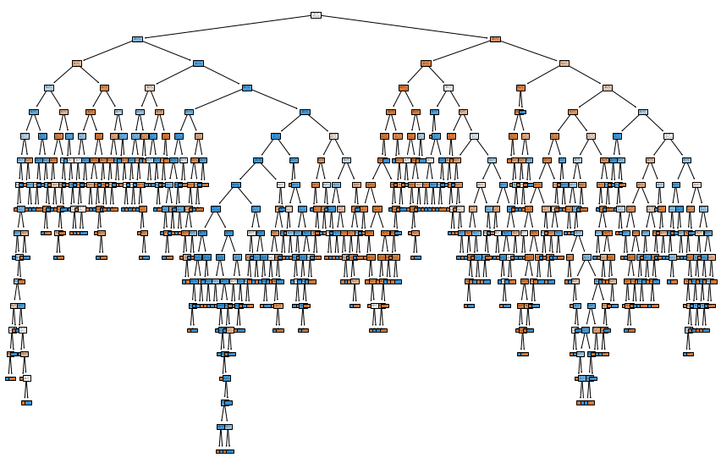
Pure Random Forest: Initial Prediction Accuracies -hansen
RF Full cleaned data set prediction accuracy: 96-97%
Top 6 feature trained model prediction accuracy: 95.4%
With only the top 6 of 171 features, very little accuracy is lost!
Visualization of 1 generated tree of 100
Notes:
Our initial testing on purely a random forest led to a prediction accuracy of 96-97% and when we train on only the top 6 features selected by the algorithm, we only lose about 1% in our accuracy.

Slide 27
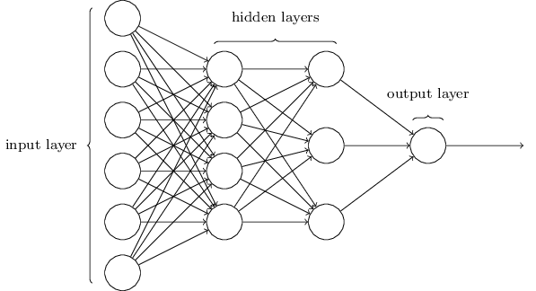
Multi-layer Perceptron(MLP)
MLP is selected over other Neural Networks because the categorical and numerical nature of our data
MLPClassifier in the sklearn model with different amount of hidden layers and nodes to reach optimal accuracy
Layers | Nodes
1 | 4
3 | 32,16,8
7 | 512,256,128,64,16,8

Slide 28
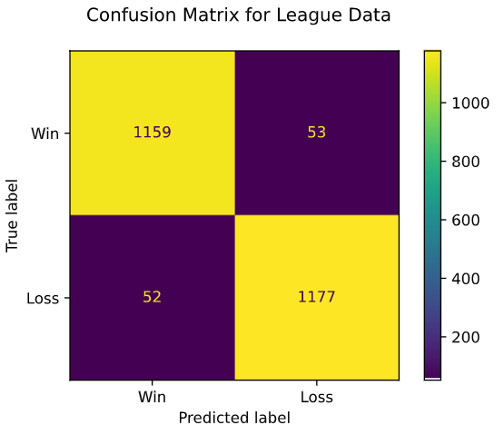
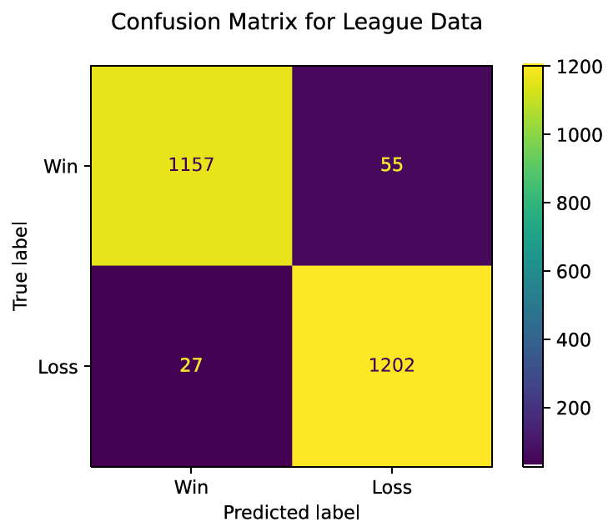
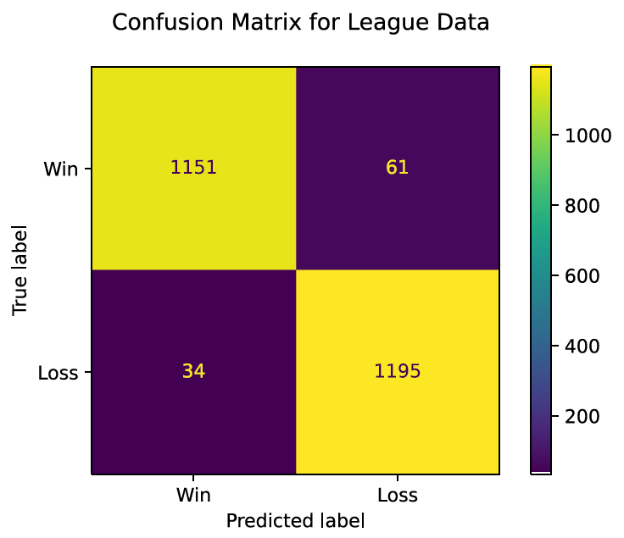
Multi-layer Perceptron(MLP)
The final model with the highest prediction accuracy (96.64%) is the single layer model with 4 nodes
Left (1-Layer)
Bottom Left (3-Layer)
Bottom Right (7-Layer)
Layers | Accuracy | Recall | Precision
1 | 96.64% | 0.95 | 0.98
3 | 95.70% | 0.96 | 0.96
7 | 96.11% | 0.95 | 0.97

Slide 29
Experiment Results - Single Models
5-fold Cross Validation:
Accuracy: 0.9735 (+/- 0.0020) [XGBoost] [time execution: 54.0256]
Accuracy: 0.9731 (+/- 0.0031) [SVM] [time execution: 753.6416]
Accuracy: 0.9693 (+/- 0.0029) [Random Forest] [time execution: 7.8166]
Accuracy: 0.9625 (+/- 0.0023) [MLP] [time execution: 23.7477]
Accuracy: 0.9485 (+/- 0.0023) [Naive Bayes] [time execution: 0.1037]
Accuracy: 0.9438 (+/- 0.0074) [Logistic] [time execution: 1.1695]
Accuracy: 0.7953 (+/- 0.0104) [KNN] [time execution: 3.0558]
All our individual models are put through the same dataset
KNN is picked as our baseline model since it has the lowest prediction accuracy

Slide 30
Experiment Results - Ensemble
StackingClassifier
StackingClassifier 2
StackingClassifier 3
Random Forest
xgboost
SVM
MLP
All Models
Random Forest
xgboost
SVM

Slide 31
Experiment Results - Ensemble
5-fold cross validation:
Accuracy: 0.9693 (+/- 0.0029) [StackingClassifier]
Accuracy: 0.9714 (+/- 0.0036) [StackingClassifier_2]
Accuracy: 0.9749 (+/- 0.0033) [StackingClassifier_3]

Slide 32
Discussion - Other Models
CNN
Good for picture and text classification
Filter over inputs
Multiple layers
Transfer Learning
Good for deep learning model
Build on existing models
High Computational Cost

Slide 33
Discussion - Champion Selection: A Separate Problem
In-game > Champion Selection analysis
Patches are deployed multiple times a year
Champion stats, abilities, and even new champions
Changes to items in the shop
Complexity scales with the large champion pool (155 currently), and interactions in 1v1 and team fighting ability
Current champion competitive win rates: https://na.op.gg/statistics/champion/
Notes:
Voice file complete
Talk a bit about why we chose to look at actions during a game rather than champion selection before the game.
Every player selects the champion they wish to play in a given match
Deciding the likelihood of a victory based on team composition alone is an extremely complex, separate classification problem:
Patches are deployed multiple times a year, with changes to champion stats, abilities, and even new champions themselves
Changes to purchasable items also significantly changes the viability of champions
Complexity scales with the large champion pool (155 currently), and interactions in 1v1 and team fighting ability
Metas are dynamic and consistently changing at the professional and amatuer level to keep gameplay fresh. The best way to analyze team composition may be the simplest: to look at each individual champions competitive win rate, such as at https://na.op.gg/statistics/champion/

Slide 34
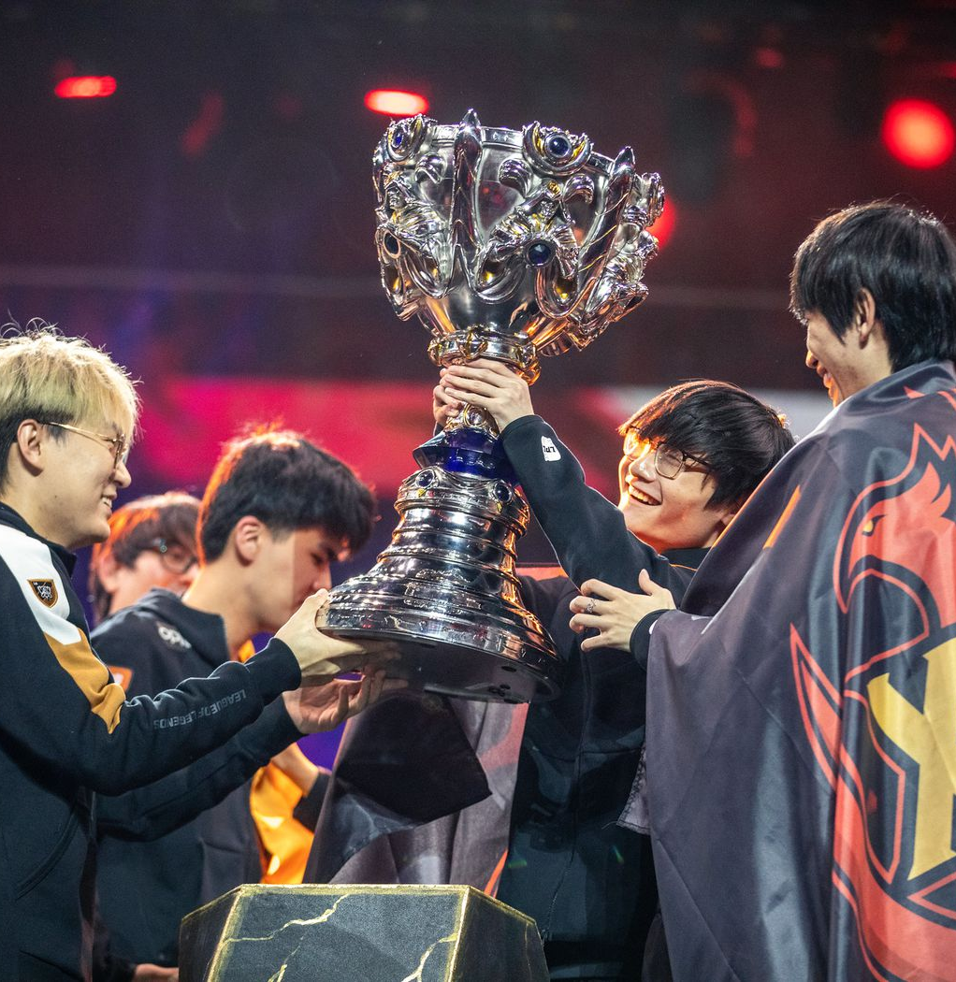
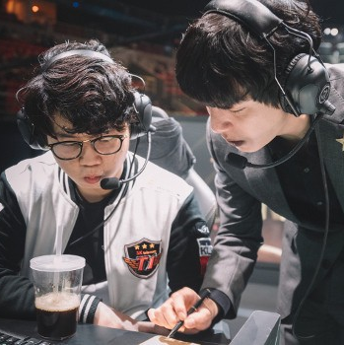
Conclusion
We achieved success in finding the key to victory in league of legends games through our clustering, feature selection, and modelling process!

